Slide 1
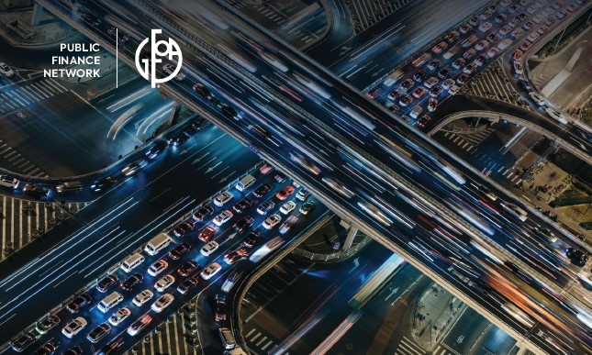
How Tax-exempt Municipal Bonds
Build Stronger Communities
Formed in 1988, the PFN is a coalition of organizations united to preserve the tax-exemption for municipal bonds. The organizations represent a wide array of public entities responsible for building and improving schools, streets, highways, hospitals, bridges, water and sewer systems, ports, airports, and other public works projects. Approximately three-quarters of the nation’s core infrastructure investments are financed with municipal bonds issued by public entities.
Formed in 1988, the PFN is a coalition of organizations united to preserve the tax-exemption for municipal bonds. The organizations represent a wide array of public entities responsible for building and improving schools, streets, highways, hospitals, bridges, water and sewer systems, ports, airports, and other public works projects. Approximately three-quarters of the nation’s core infrastructure investments are financed with municipal bonds issued by public entities.

Slide 2
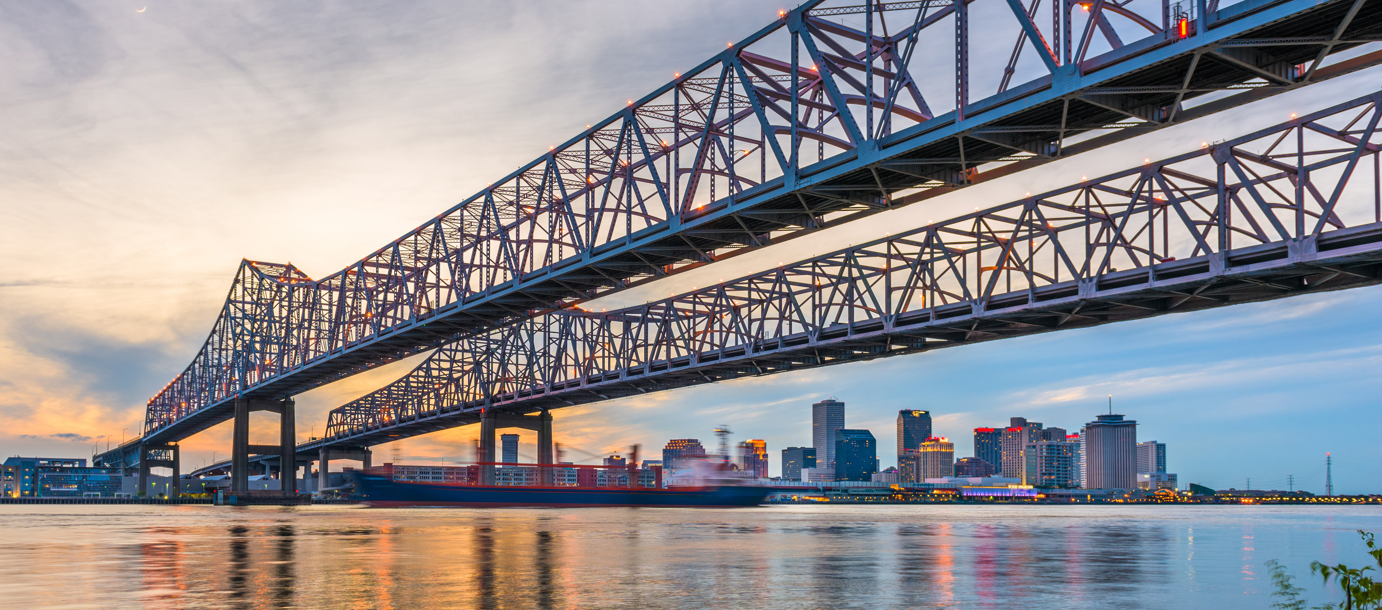

U.S. Infrastructure in the IIJA Era
Emily Feenstra
Chief Policy & External Affairs Officer, ASCE
Notes:
Good morning and thank you for having me here today to talk about the Infrastructure Investment and Jobs Act – the IIJA.
I’m Emily Feenstra, Chief Policy & External Affairs Officer at ASCE.
The IIJA was signed into law in November 2021 by President Biden. It was the culmination of eight months of negotiation by Congress and the Administration, and several iterations of legislation.

Slide 3

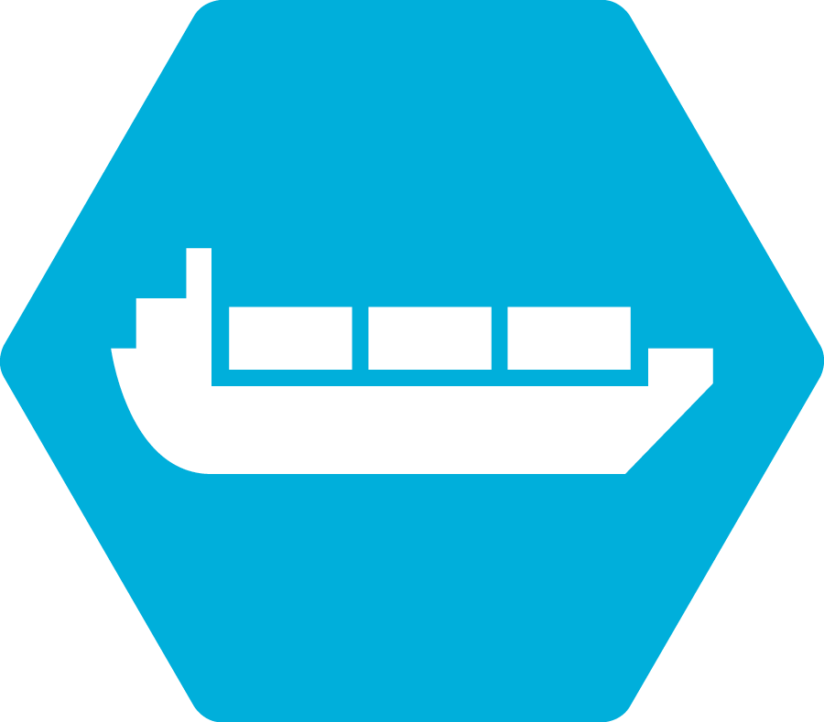









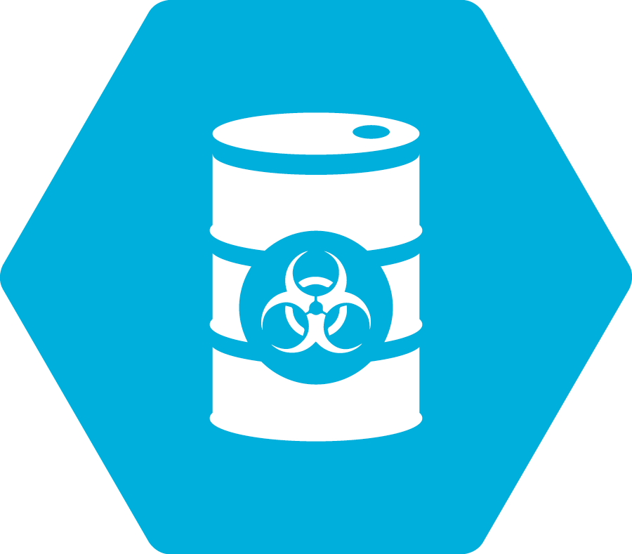






2021 Infrastructure Grades
AVIATION
D+
PORTS
B-
America’s Cumulative Infrastructure Grade
BRIDGES
C
RAIL
B
DAMS
D
ROADS
D
DRINKING WATER
C-
SCHOOLS
D+
ENERGY
C-
SOLID WASTE
C+
A
EXCEPTIONAL
HAZARDOUS WASTE
D+
STORM WATER
D
B
GOOD
INLAND WATERWAYS
D+
TRANSIT
D-
C
MEDIOCRE
LEVEES
D
D+
D
POOR
WASTEWATER
F
FAILING
PARKS AND RECREATION
D+
Notes:
For the first time ever in 2021 Report Card, America’s cumulative GPA is a C-. This GPA is improved slightly from a “D+” in 2017, indicating we’ve made progress around the margins in some infrastructure areas. However, eleven categories are still in the “D” range.
Those include much of the infrastructure Americans interact most closely with every day like roads, transit, and dams and levees. Often, these categories are where we’ve failed to make investments needed to maintain the assets that were built 50 years or longer ago.
Transit is a glaring example of this, receiving the lowest grade of a D- because of the growing backlog of needs, lack of access for nearly half of Americans, and aging major systems.
Rail received the highest grade. Our nation’s freight rail system is a strong network largely supported through direct shipper fees — investing on average over $260,000 per mile. However, our passenger rail system – i.e. Amtrak – is plagued by a lack of federal support, leading to a current state of good repair backlog at $45.2 billion.
Overall in 2021, five categories – aviation, drinking water, energy, inland waterways, and ports – benefitted from increased federal funding and improved asset management. These grade bumps contributed to the improved GPA.
One category, bridges, saw its grade go from a C+ to a C. The rate of bridge improvements has slowed and at the current investment rate, it will take us until 2071 to make all the repairs necessary – not even accounting for the additional needs to come in that time.

Slide 4


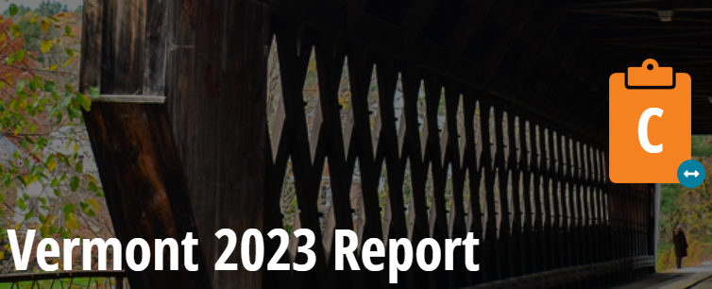
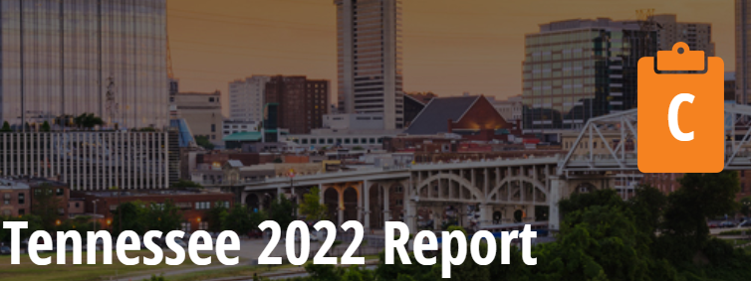
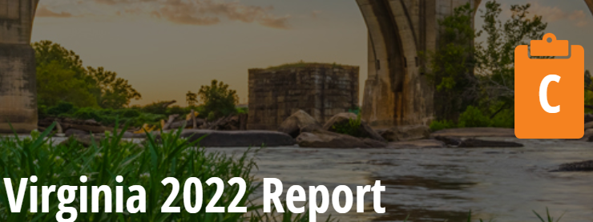
Recent State Report Cards
Notes:
Infrastructure is middling along – we’re starting to see the impacts particularly of COVID-era spending on things like drinking water and wastewater systems.
But in states like Pennsylvania, where infrastructure is old and maintenance backlogs are significant, they’re eagerly awaiting additional federal support to help bridges, roads, and more.
In the last year, overall grades in state report cards have mostly stayed stable from each state’s previous report card. Some category grades increase and some decrease.
State report cards in the last year have universally identified COVID-19 pandemic changes as short- and perhaps long-term shifts in infrastructure usage and challenges. Inflation is a persistent major factor constraining implementation of shovel-ready projects and operations/maintenance work. The “supply-chain crisis” remains in some materials and markets.
Workforce challenges to all infrastructure stakeholders are identified in recent state report cards with ASCE members within government agencies, the private sector, and academia suggesting creative approaches to gaps in high-skill and technical positions.

Slide 5
Investment Needs
Category | Total Needs | Funded | Funding Gap
$2.59
Trillion
needed
SURFACE TRANSPORTATION¹ | $2,834 | $1,619 | $1,215
WATER/ WASTEWATER/ STORMWATER² | $1,045 | $611 | $434
ELECTRICITY² | $637 | $440 | $197
AIRPORTS² | $237 | $126 | $111
INLAND WATERWAYS & MARINE PORTS² | $42 | $17 | $25
DAMS³ | $93.6 | $12.5 | $81
HAZARDOUS & SOLID WASTE⁴ | $21 | $14.4 | $7
LEVEES⁵ | $80 | $10.1 | $70
PUBLIC PARKS & RECREATION⁶ | $77.5 | $9.5 | $68
SCHOOLS⁷ | $870 | $490 | $380
CURRENT
FUNDING
FUNDING GAP
TOTALS | $5,937 | $3,350 | $2,588
Notes:
The most recent analysis reveals that while we’ve made incremental immediate gains in some of the infrastructure categories, our long-term investment gap continues to grow. We’re still just paying about half of our infrastructure bill – and the total investment gap has gone from $2.1 trillion over $10 years to $2.59 trillion over 10 years.
Surface transportation remained relatively steady, with just a slight bump in the funding gap over 10 years, which is to be expected as our maintenance needs remain unaddressed.
Water, wastewater, and stormwater saw the biggest jump in needs compared to the 2017 estimate. This is due to:
The new category of stormwater;
Approaching or surpassed end of service lives of the pipe networks.
Better understanding of resilience;
We looked at what EPA didn’t count.
Dams: Our dams gap has doubled from approx. $40 billion to $81 billion. This is primarily due to a more comprehensive inventory and assessment of federal funding needs which we did not do last time.
Parks: A bright spot! The Great American Outdoors Act is helping to decrease the 10-year funding gap significantly. Our gap has shrunk from $102 billion to $68 billion over 10 years!

Slide 6
Funding Before and During the Bipartisan Infrastructure Law
Notes:
The IIJA was signed into law in November 2021 by President Biden. It was the culmination of eight months of negotiation by Congress and the Administration.
The legislation is a historic, once-in-a-generation investment in our roads, bridges, water and wastewater networks, ports, electric grid, dams, and more. A total of $1.2 trillion will be invested in core infrastructure over the next five years.
The bill increases funding, makes smart improvements to policy such as streamlining permitting, and creates new programs targeted at all 17 categories in the 2021 Report Card for America’s Infrastructure. Overall, The bill is a significant down payment on the $2.5 trillion infrastructure investment gap that was identified in the 2021 Report Card and will benefit American businesses and families for years to come.
In total, the IIJA answers 43 of the recommendations included in the 2021 Report Card.
In the roads and bridges categories, the IIJA addresses eight of the recommendations ASCE made to raise the grades in these categories. The goals include increasing funding, focusing resources on preserving roads in a state of good repair, and prioritizing the rehabilitation and preservation of bridges in fair condition.
IIJA addresses 12 of ASCE’s recommendations concerning drinking water, stormwater, and wastewater. IIIJA provides $55 billion to upgrade water infrastructure, including reauthorization of the Clean Water and Drinking Water State Revolving Funds (SRF), IIJA also provides funding to eliminate lead service lines, $50 million for a resilience and sustainability grant program, and $510 million over five years to establish disadvantaged communities grant program. To address stormwater needs, IIJA provides $5 million per year to complete the Clean Watershed Needs Survey biennially, funding on Stormwater Best Management Practices, NOAA flood mapping assistance and authorizes $280 million annually for sanitary sewer overflows with requirements to allocate at least 25% of such funds towards systems serving rural or disadvantaged communities. For wastewater, IIJA reauthorizes the Clean Water SRF at $11.7 billion over 5 years and provides $10 billion to address emerging contaminants.
IIJA also answers ASCE’s recommendations in transit, rail, ports, inland waterways, and includes the largest-ever federal investment in resilient infrastructure.
Now it is critical that the law is implemented efficiently, and resources used wisely, because there are infrastructure projects across the country that need urgent attention. With funding broken out over 350 distinct programs, including 129 NEW federal infrastructure programs (86 which are competitive), and programs across more than a dozen federal agencies, implementation will take time and ASCE is urging agencies and state and local governments to work together to effectively deploy these historic investments.

Slide 7
IIJA Progress Report: Dollars Out the Door as of March 14, 2023
Category | Approx. Funding to Date | Total Amount (over 5 yrs)
Bridges & Roads | $128 billion | $350 billion
Drinking Water, Wastewater & Stormwater (SRF funds) | $8.8 billion | $44 billion
Inland Waterways & Ports | $3.7 billion | $17 billion
Airports | $5.92 billion | $25 billion
Rail |  | $66 billion
Transit | $3.1 billion (not including CIG) | $92 billion
Broadband | $5 billion | $65 billion
Resilience, Energy, MISC | ~$17.9 billion | $153 billion
Notes:
We’re now over a year into the five-year, $1.2 trillion Infrastructure Investment and Jobs Act, or IIJA. Once the (very delayed) Appropriations Act of 2022 was signed into law in mid-March, the significant plus ups in formula funding were released and the grant application process began in earnest.
Included on this slide are approximate funding released to date. The quickest dollars out the door were for existing formula programs as well as new programs that followed traditional formula funding equations, such as the Bridge Formula Program dollars and initial RAISE grants.
Some interesting DOT grant metrics:
As of the end of the calendar year, 96 percent of DOT’s fiscal 2022 competitive grant funding (excluding CIG), or $22.4 billion, had been made open for application by the Department.
For the first year of the IIJA (fiscal year 2022), the amount of competitive grant money available to the Secretary of Transportation from all sources (the IIJA, plus regular, annual DOT appropriations) totaled around $28 billion (source: ENO). The comparative total for fiscal year 2021 was only around $5.5 billion, so the IIJA quintupled the amount of money the Secretary gets to give out every year.
The biggest area of delay is the IIJA emphasis on rail programs. The law provides $7.2 billion per year for grants for new and improved intercity passenger rail service (the NOFO was just released in January).

Slide 8
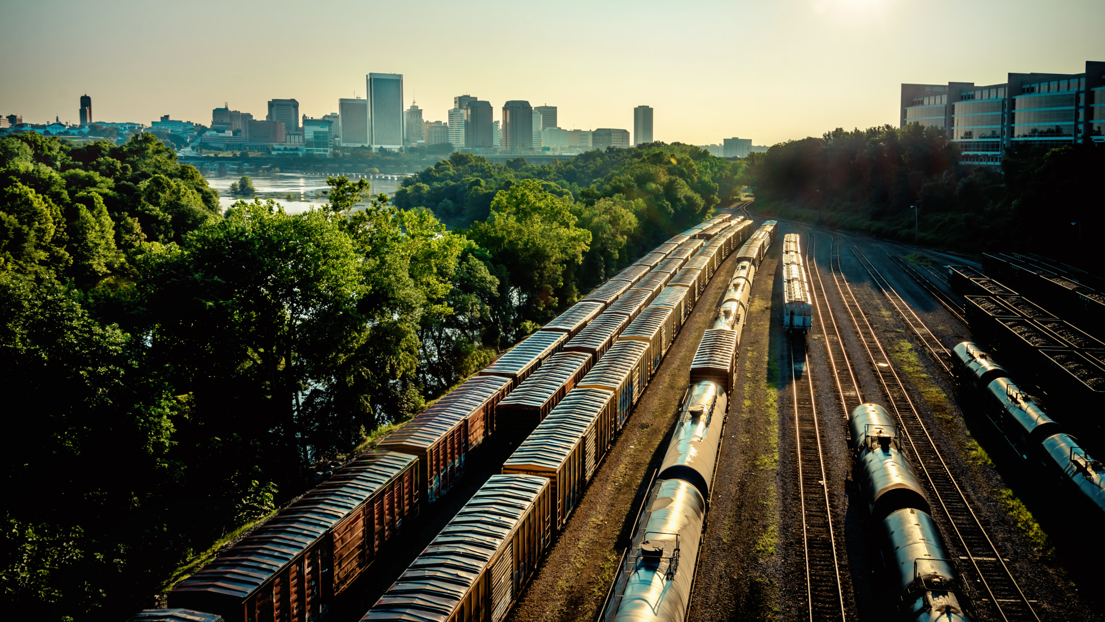

Thank You
www.infrastructurereportcard.org | reportcard@asce.org
Notes:
Thank you again for the opportunity to share the Report Card with you today, and for your interest in the backbone of our economy and daily lives.
All Americans share a role in renewing the nation’s infrastructure. Increased interest and recent federal actions boosted our GPA to C-. but there is still so much more work to be done to ensure we have infrastructure ready for the future. We can’t afford not to.

Slide 9
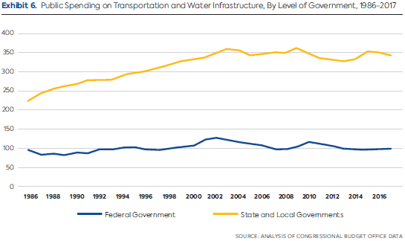
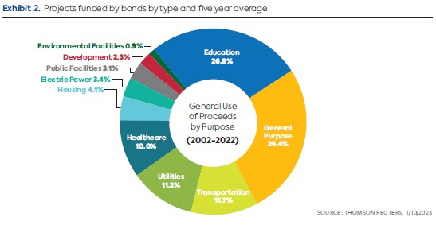
Why tax-exempt municipal bonds?

Slide 10
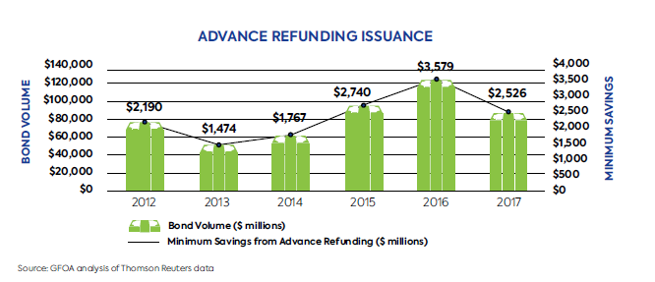
Tax-exempt Advance Refunding
  Prior to 2017 tax reform, issuers could advance refund one time
  Best practice called for a minimum savings (at least) 3% of par
  HR 1837 Investing in Our Communities Act

Slide 11
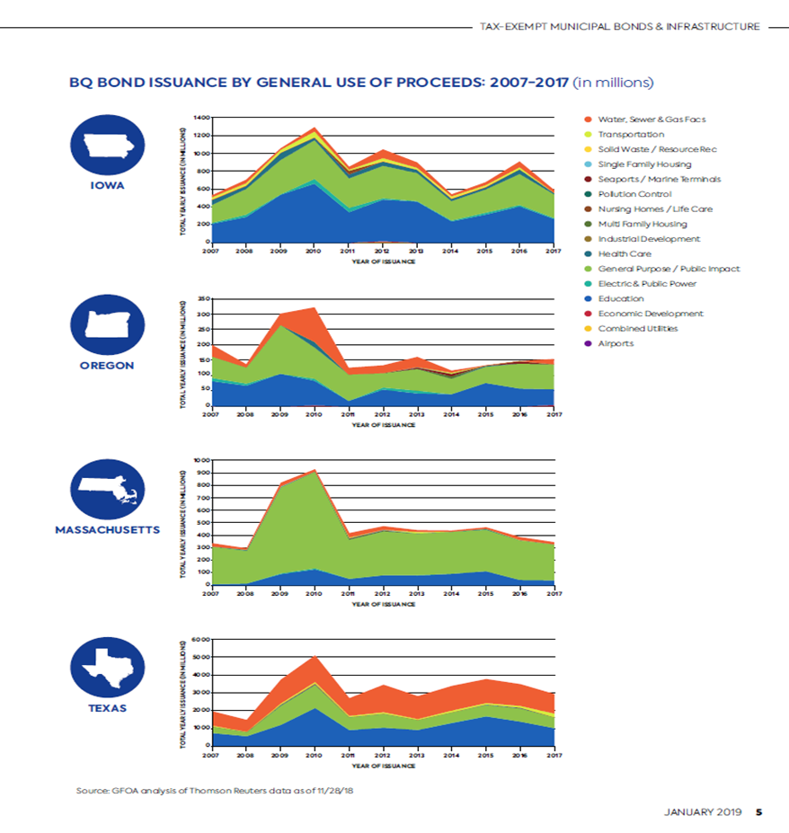
Bank Qualified (aka Small Issuer Exception)
  Small Issuer Exception allows smaller jurisdictions working with community banks to issue TE BQ debt = COST SAVINGS
  Right now the cap is $10M per issuer, we are asking to raise the cap to $30M, pegged to inflation and based at the level of the borrower
  Past efforts include:
    HR 3967 Municipal Bond Market Support Act (116th)
    HR 2634 LIFT Act (117th)

Slide 12
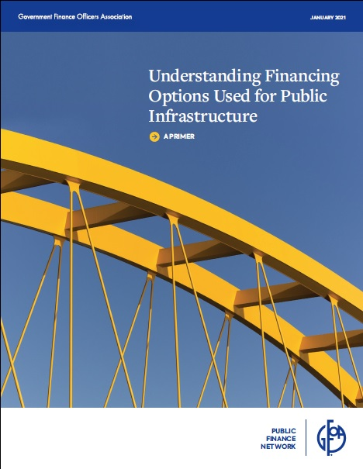
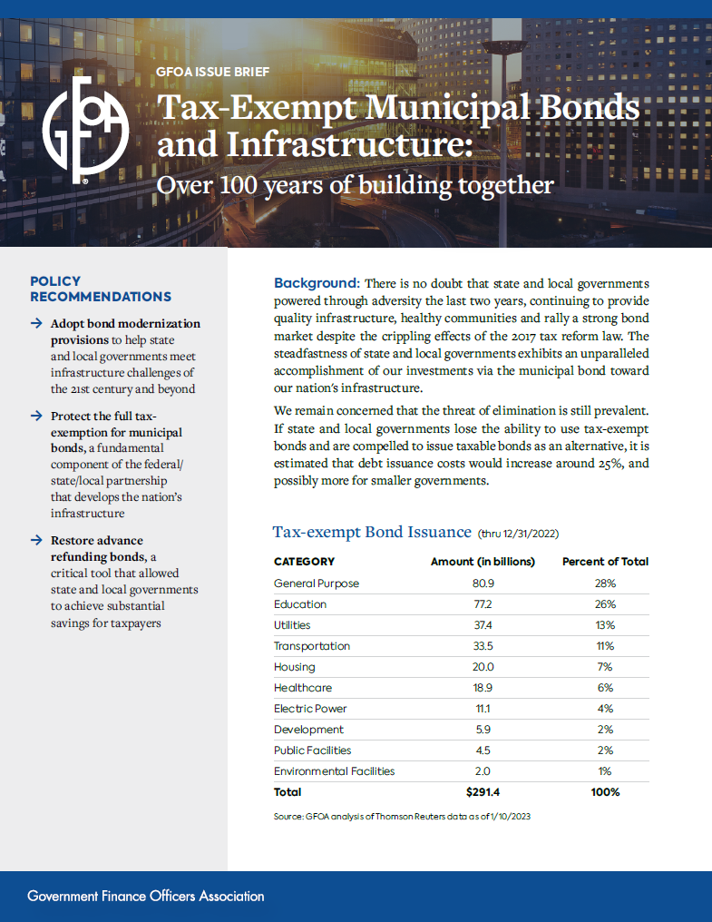
PFN Resources – www.gfoa.org

Slide 13
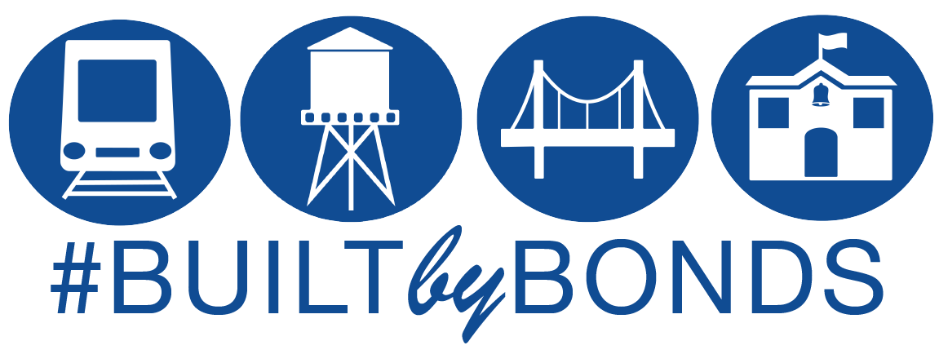

Slide 14
Public Finance Network
Kishia L. Powell, General Manager & CEO
April 25, 2023

Slide 15
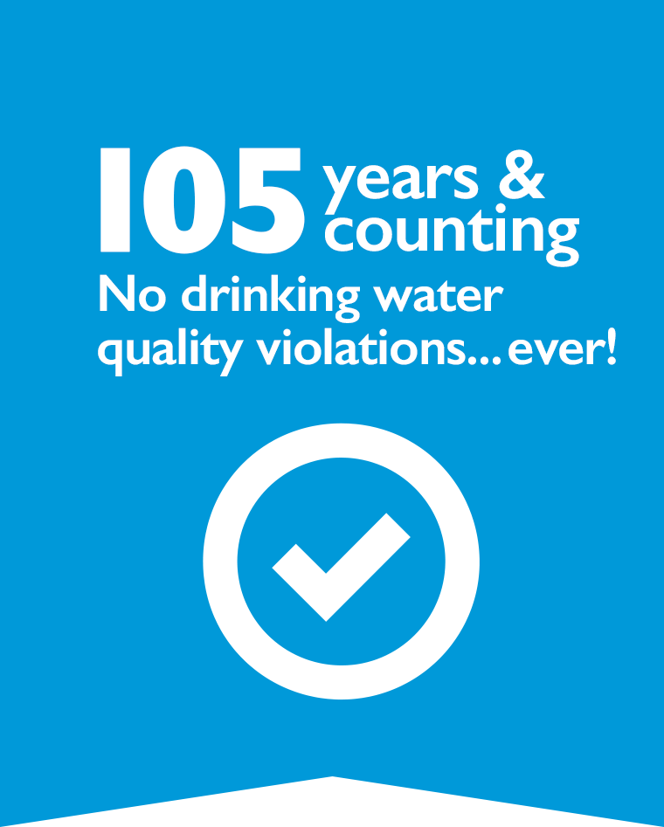
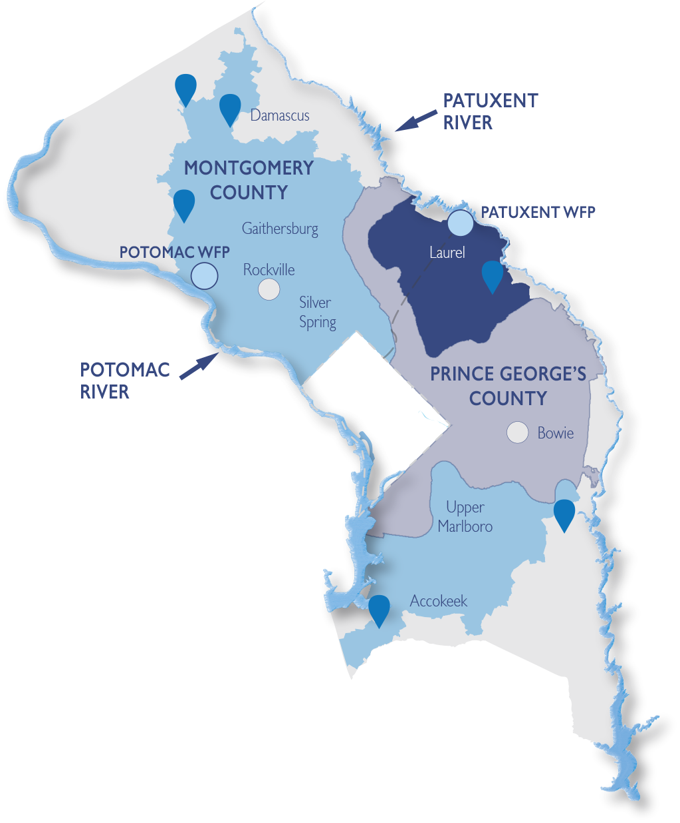

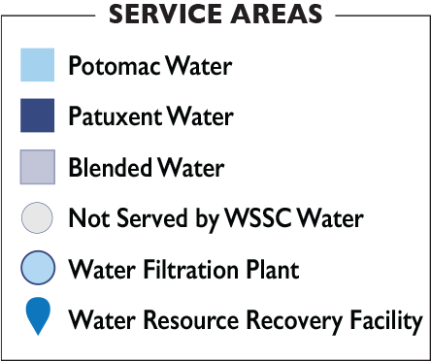
Established in 1918, WSSC Water is the largest
water/wastewater utility in Maryland and among
the largest in the nation. Our service area spans
approximately 1,000 square miles in Prince George’s and Montgomery counties. We proudly serve 1.9 million residents with safe and reliable drinking water and help protect the Chesapeake Bay by treating and returning clean water back to Maryland waterways.
Notes:
WSSC Water is the largest water utility in Maryland serving 1.9 million customers in Prince George’s and Montgomery Counties
For 105 years and counting, WSSC Water has provided exceptional drinking water quality

Slide 16
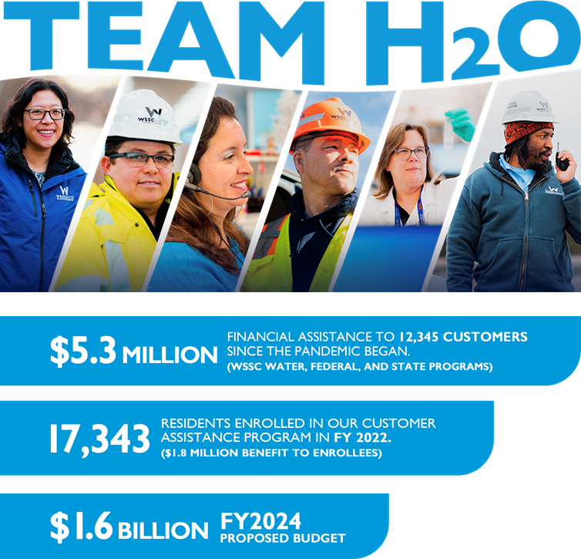
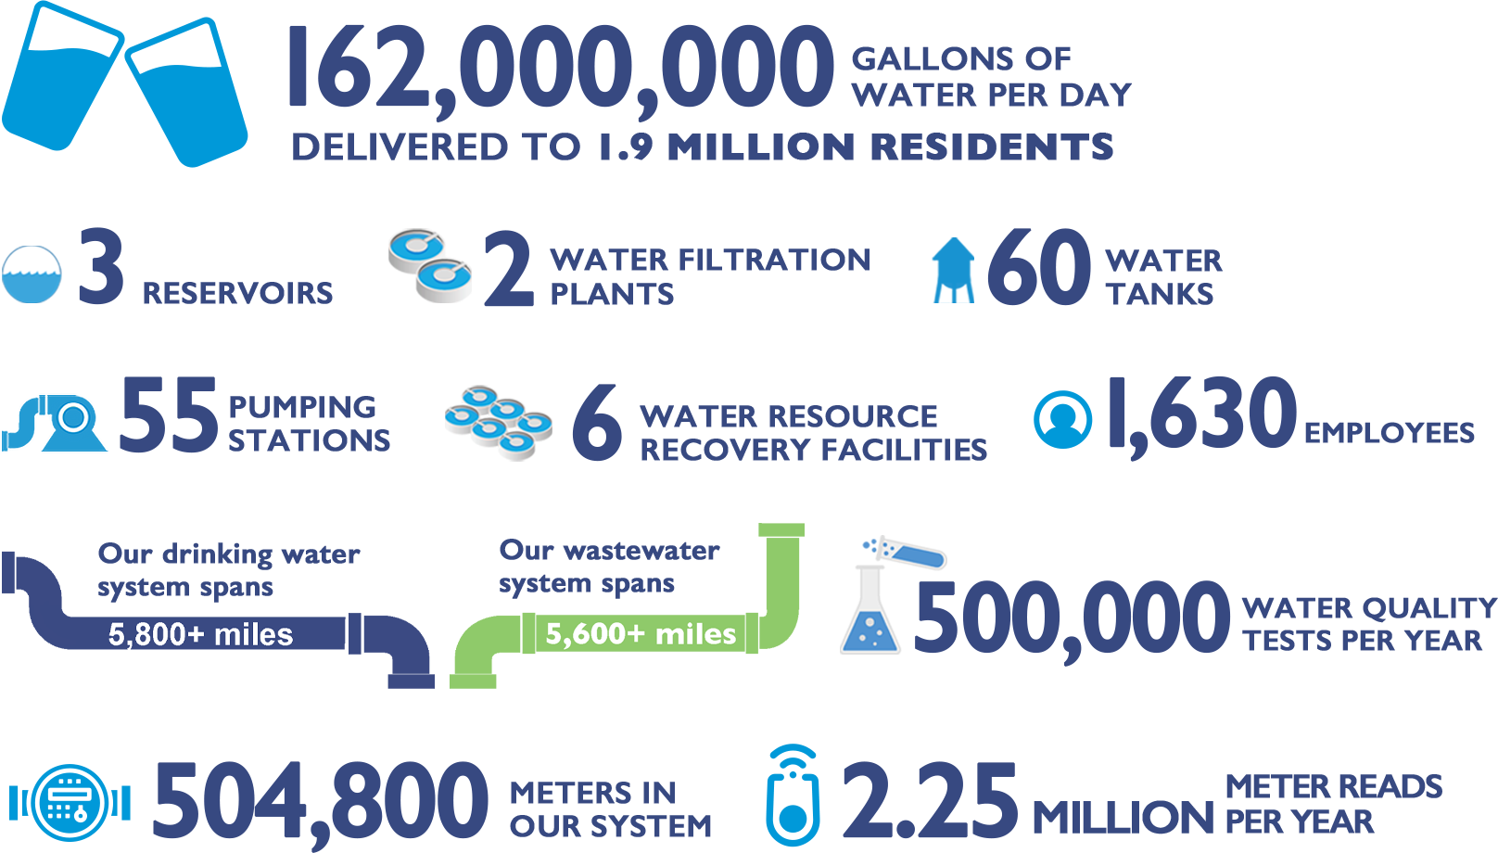
Notes:
We are maintaining $9 Billion in assets

Slide 17
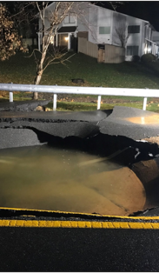
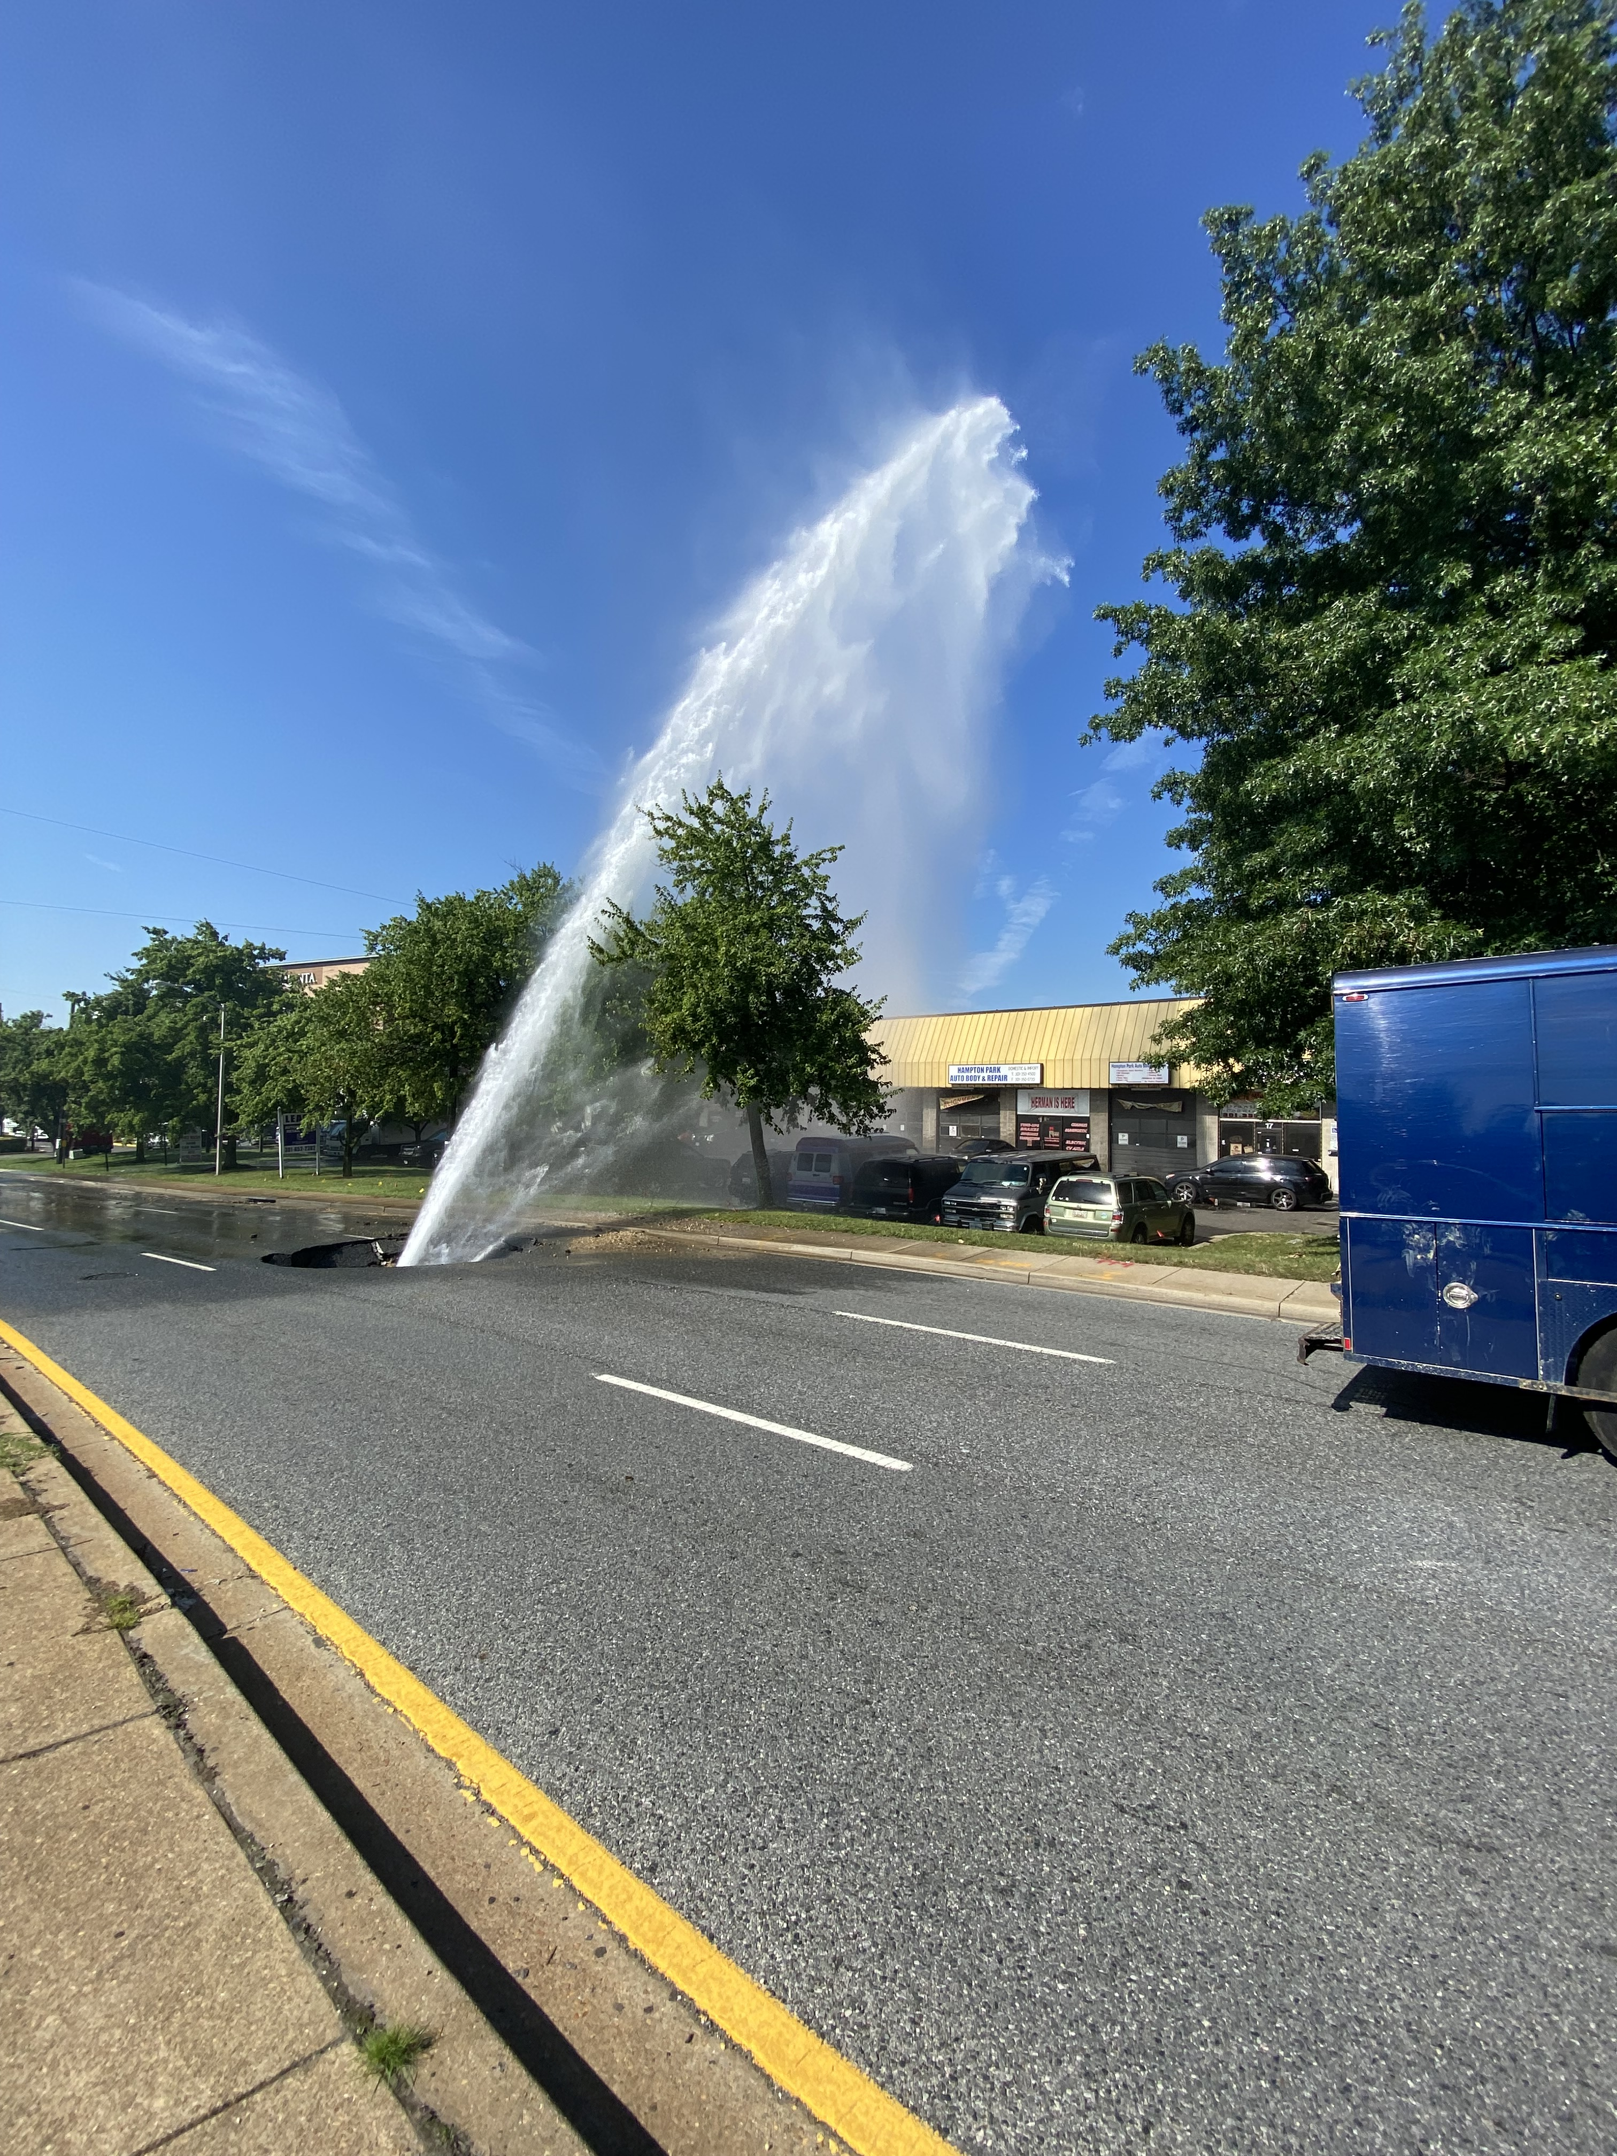
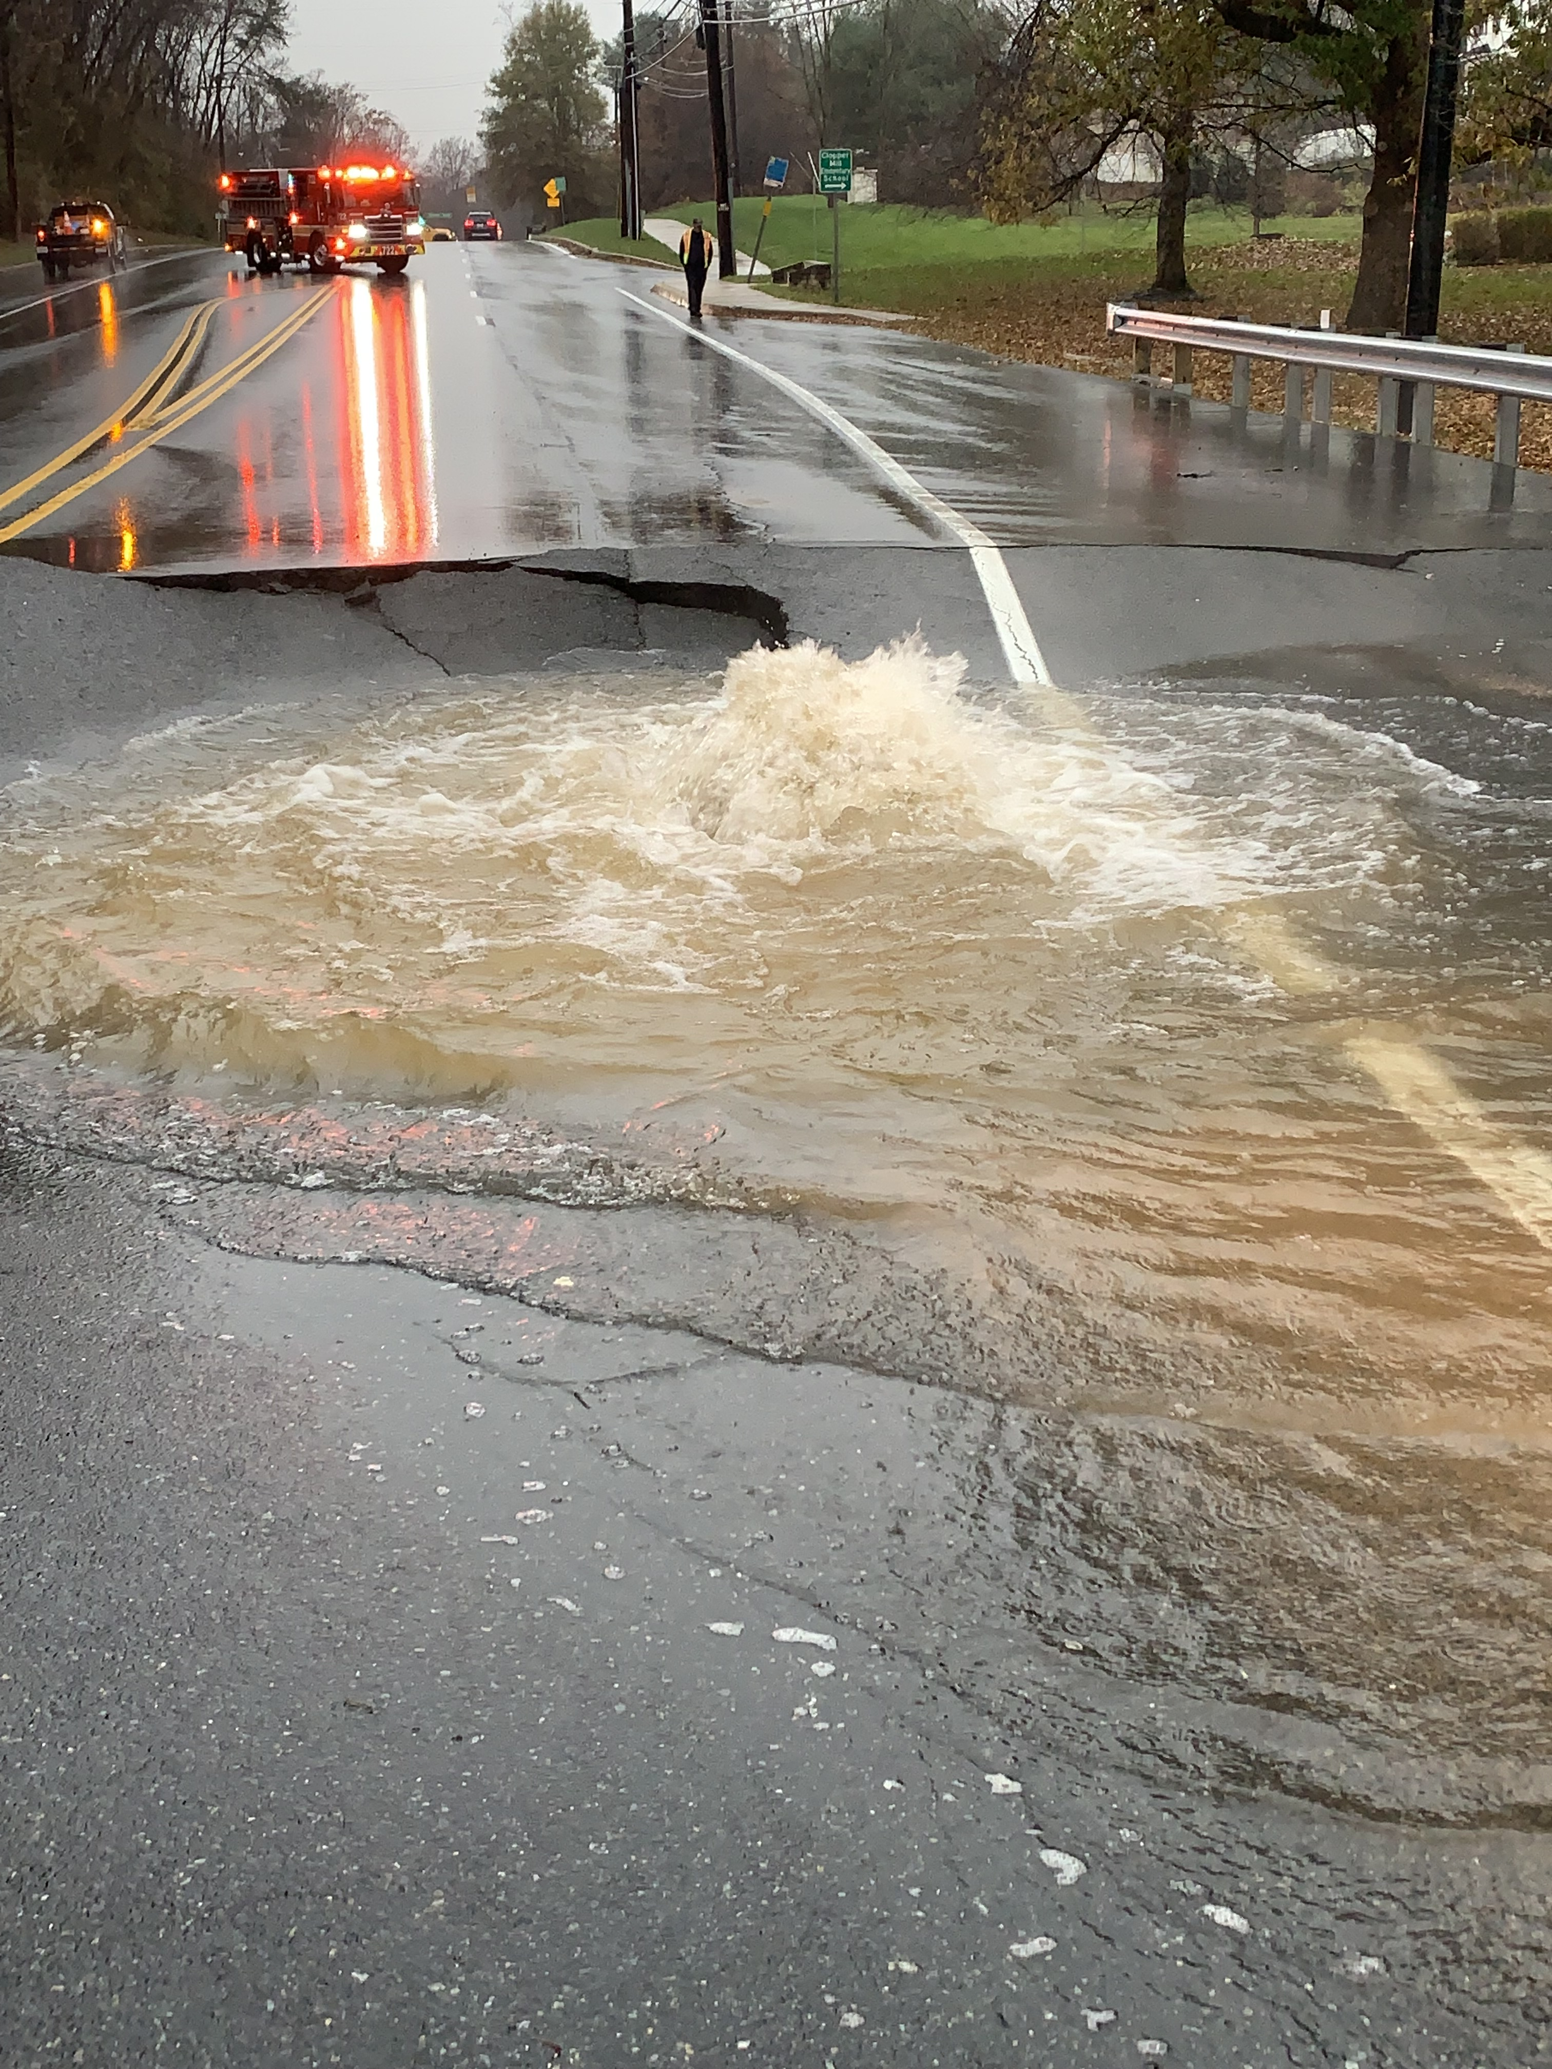

Slide 18
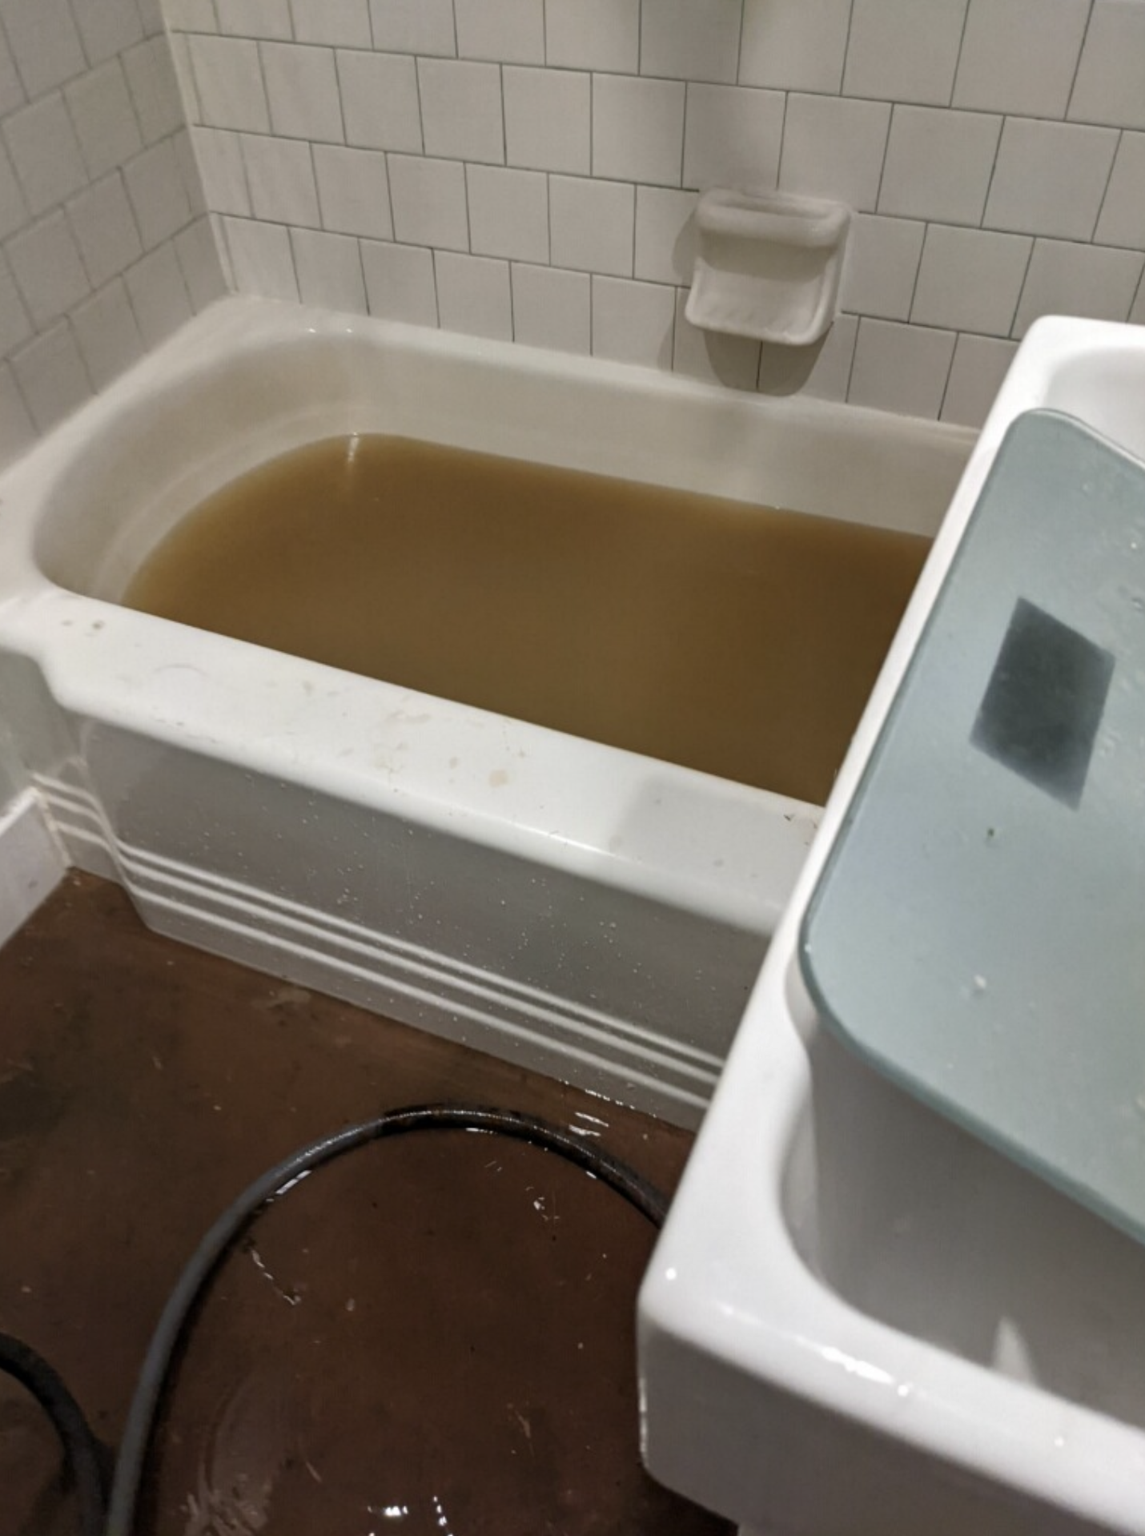
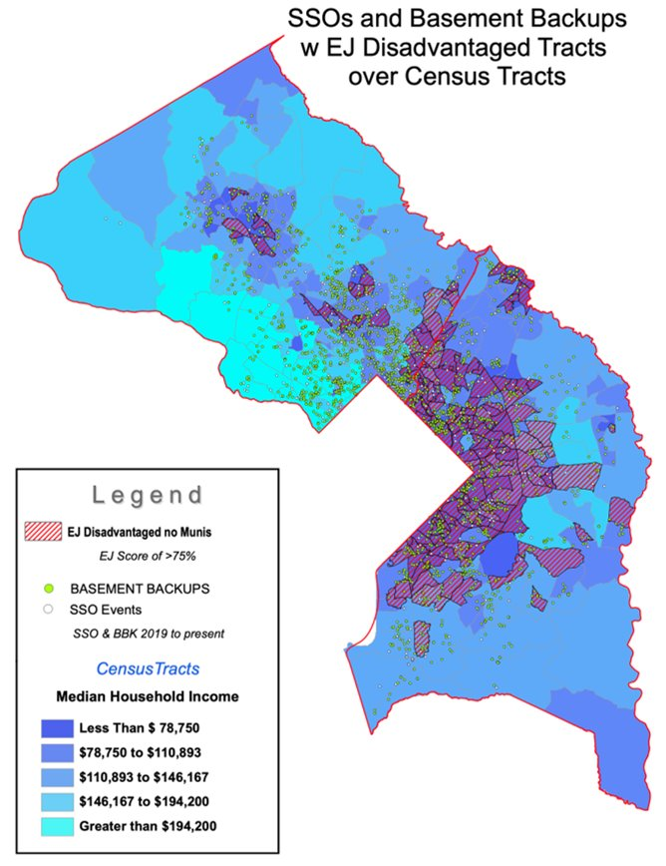
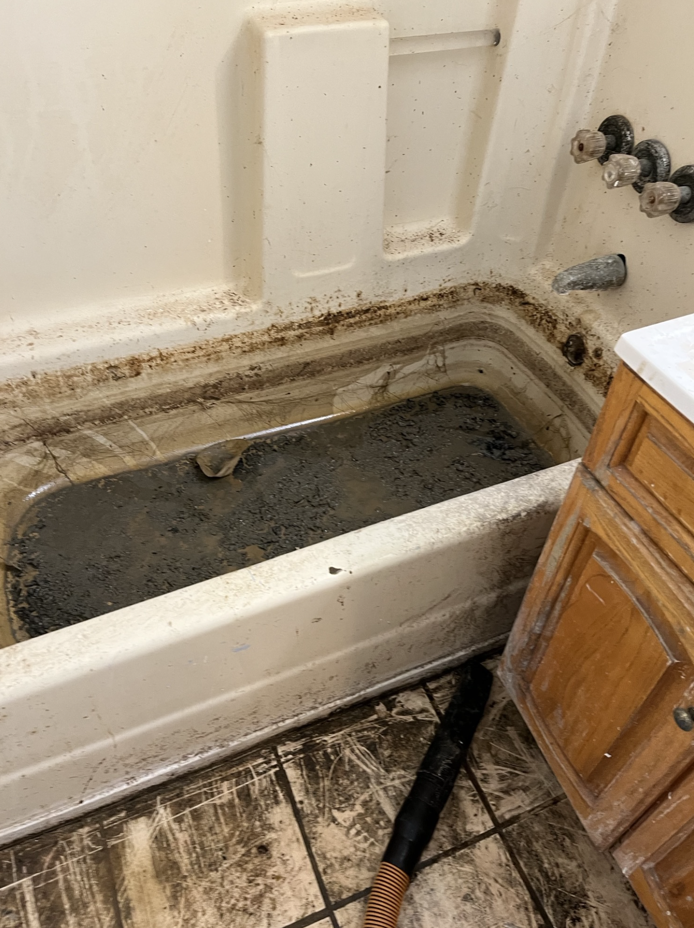
SSO and Basement Backups
Notes:
But even when our most innovative project comes online next year, we will still have to rapidly respond to Sanitary Sewer Overflows, or SSOs, and assist customers with basement backups.
And one of the biggest causes of SSO and basement backups is blockages in sewer mains caused by grease.
Launched Can the Grease public education campaign.

Slide 19
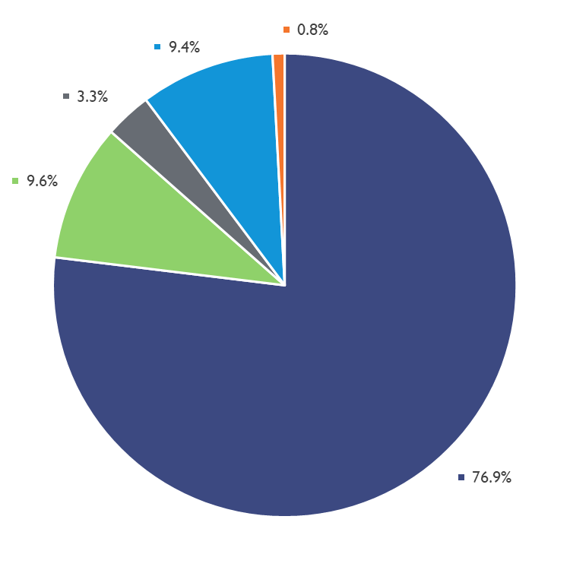
Funding for Water and Sewer Capital Expenditures FYs 2023-2028

Slide 20
FY 2024 Capital Program Overview & Highlights
79%
of the FY 2024 Capital program is funded through long-term debt

Slide 21







Impact of Loss of Tax-Exempt Bonds
The loss of tax-exempt bonds to WSSC Water:
$1.1billion in cuts needed to offset increased interest payment
Over 30 years - cuts equivalent to:
91 positions
203 miles of sewer reconstruction & 165 miles of water main replacements
1,290 large vehicles
Notes:
If we were to lose the tax exemption on our bonds our interest costs would increase by $1.1 billion
Over 30, years the cuts would be equivalent to 1,290 large vehicles AND
Replacing 203 miles of sewer mains and 165 miles of water mains AND
Eliminating 92 positions effective immediately
Let me be clear, the equivalent cuts are just for comparison purposes. I want to make sure people know we are not cutting positions.
But we would have very difficult choices to make in terms of cuts if we were to be downgraded.

Slide 22
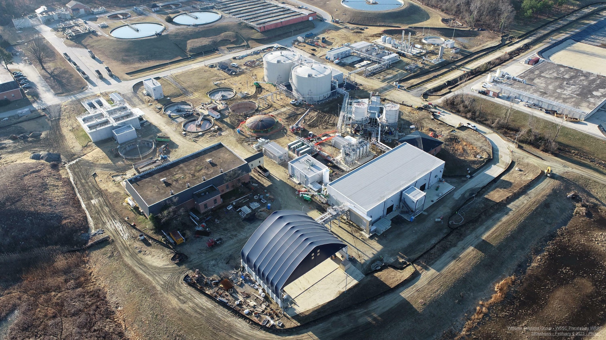
Notes:
Future projects and strategies in WSSC Water’s long-term GHG mitigation in our planning include the startup of the Piscataway Bioenergy project, a biogas production facility nearing completion at Piscataway WRRF.
At the heart of the project is how WSSC Water handles biosolids, the nutrient-rich organic material resulting from the wastewater treatment process.
Our water resource recovery facilities currently produce about 8,000 tons of biosolids monthly.
Through innovative technology, the amount of biosolids left over from the new treatment process will be significantly reduced and cleaner (Class A).
Creating these Class-A biosolids will generate methane gas, which will be captured and upgraded to renewable natural gas (RNG) that WSSC Water will sell on the open market.
The RNG will also be used to help power the plant, reducing our GHG emissions.
Selling RNG will generate Renewable Fuel Credits, which can be sold to generate additional revenue for WSSC Water.
WSSC Water is also pursuing strategies such as optimizing treatment processes to reduce energy needs, and exploring wastewater thermal exchange technology for renewable heating and cooling facilities.

Slide 23

Notes:
Drinking water!!!!

Slide 24

Municipal Bonds
Financed Projects and
Impact of Advanced Refundings
Jason Friess
Debt Manager
April 25, 2023

Slide 25
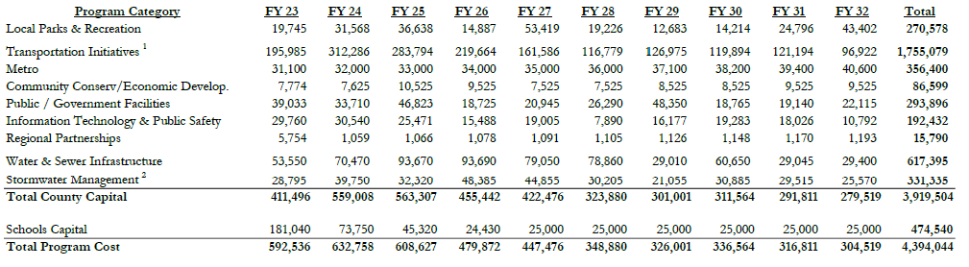
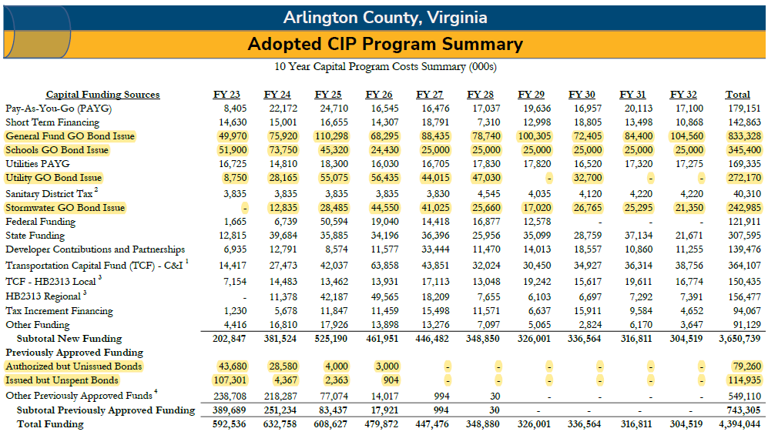
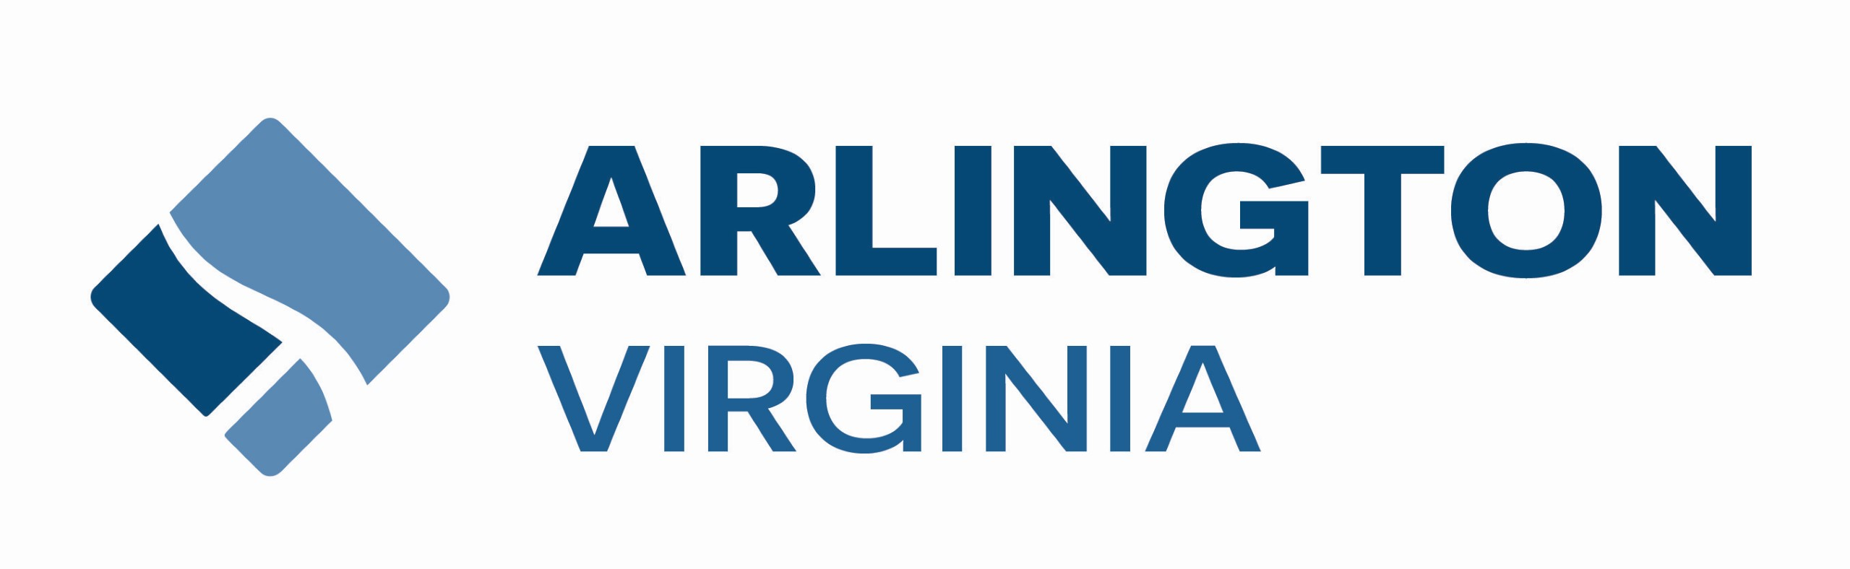
Impact of Municipal Bonds
40% of Arlington’s Capital Projects Funded with Municipal Bonds
  Arlington issues approximately $150 million annually
  Single largest funding source for capital projects
  Parks
  Government Facilities
  Transportation & Public Transit
  Public Schools
  Stormwater
  Water and Wastewater

Slide 26
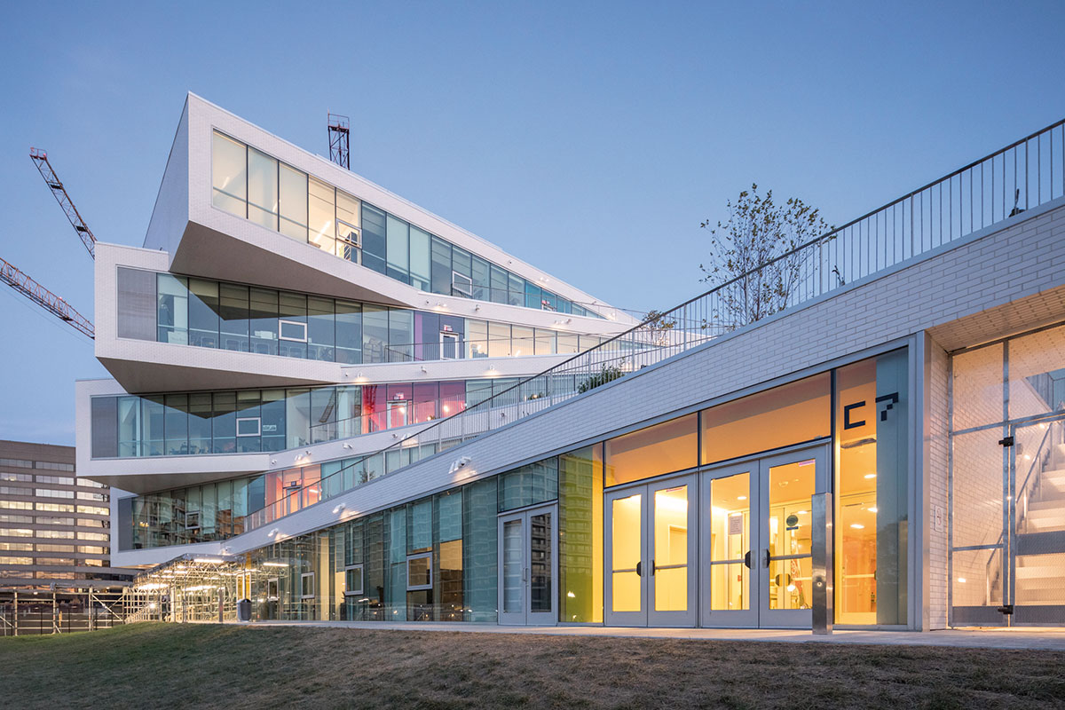
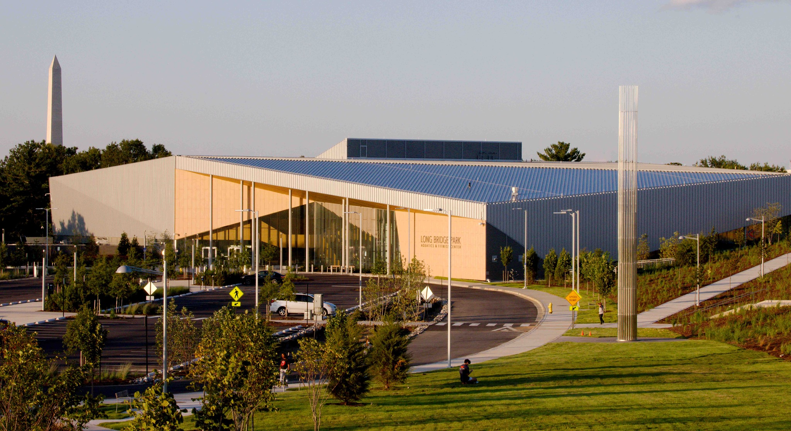
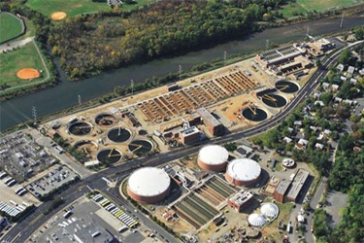
What we fund with municipal bonds
Public Safety
Schools
Fire Station 8 (Rosslyn)
HB Woodlawn
Parks
Utilities
Long Bridge Park
Water Pollution Control Plant

Slide 27
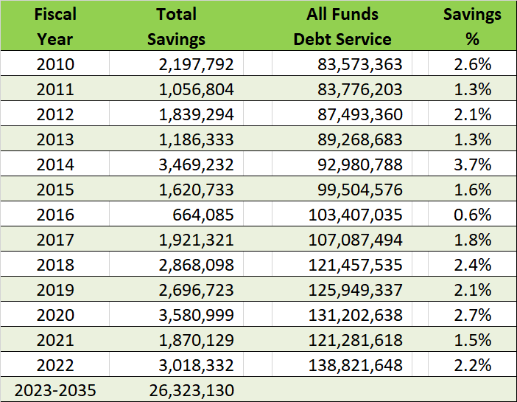
Advance Refundings Save Taxpayers Money
$590 million of debt refinanced from 2009 – 2018
1 penny on Arlington’s tax rate
$8 million
Refundings
2010 – 2018: 10
2019 – 2023: 2
Debt service savings of $54 million
from advance refunding of bonds

Slide 28
Thank You!
Formed in 1988, the PFN is a coalition of organizations united to preserve the tax-exemption for municipal bonds. The organizations represent a wide array of public entities responsible for building and improving schools, streets, highways, hospitals, bridges, water and sewer systems, ports, airports, and other public works projects. Approximately three-quarters of the nation’s core infrastructure investments are financed with municipal bonds issued by public entities.

